Slide 1
Store Keeper & Store Manager Training
Inventory and Asset Management in the ERP

Slide 2
The big picture
Goods IN: Goods Received Note (GRN) -> Confirm GRN -> registers updated automatically
Goods OUT: Employee requests -> Store Manager approves -> Store Keeper posts -> asset marked Issued / stock reduced
Goods BACK: Items Issued to Staff -> Return Item -> asset Available again
Consumables (paper, toner...) live in the Inventory Register, counted by quantity
Assets (laptops, phones, chairs...) live in the Asset Register, one Tag No. per unit
Finance creates Item and Fixed Asset cards. The store only receives, issues, takes back and counts.

Slide 3
How inventory management works
 | Consumables | Assets
Examples | Paper, hand soap, toner | Laptops, monitors, chairs
Tracked in | Inventory Register | Asset Register
Counted by | Quantity | One row per unit, unique Tag Number
Comes back? | No, used up | Yes, returned later
Master record | Item card (Finance) | Fixed Asset card (Finance)
Finance creates the Item and Fixed Asset cards. The store works with the registers.

Slide 4
The life of stock
1 Buy
Purchase Order raised and released
2 Receive
Create GRN on the order (Store Keeper)
3 Confirm
Check delivery, fill in details, Confirm GRN: registers updated
4 Shelve
Store it; tag every asset
5 Request
Employee creates a Store Requisition
6 Approve
Store Manager: Approve for Issue
7 Issue
Store Keeper picks Tag No. and posts: asset Issued, consumable reduced
8 Return
Return Item: asset Available again
9 Count
Compare shelf with system; explain any Variance

Slide 5
Who does what
Role | Responsibility
Employee | Requests items or assets
Store Manager | Approves requisitions; reviews counts and adjustments
Store Keeper | Receives, shelves, issues, takes back and counts
Finance | Creates item and asset cards; depreciation and accounting
Before issuing consumables, make sure the Physical Count is entered on the Inventory Register row.

Slide 6
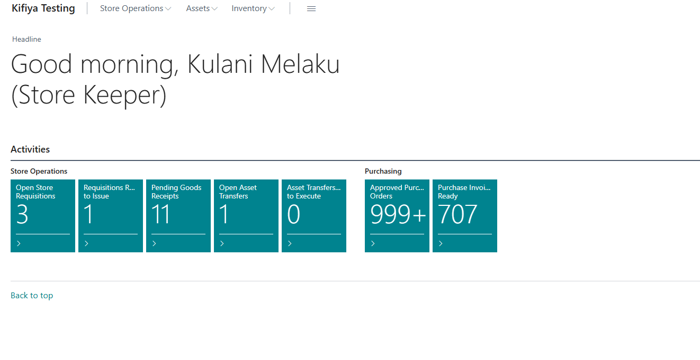
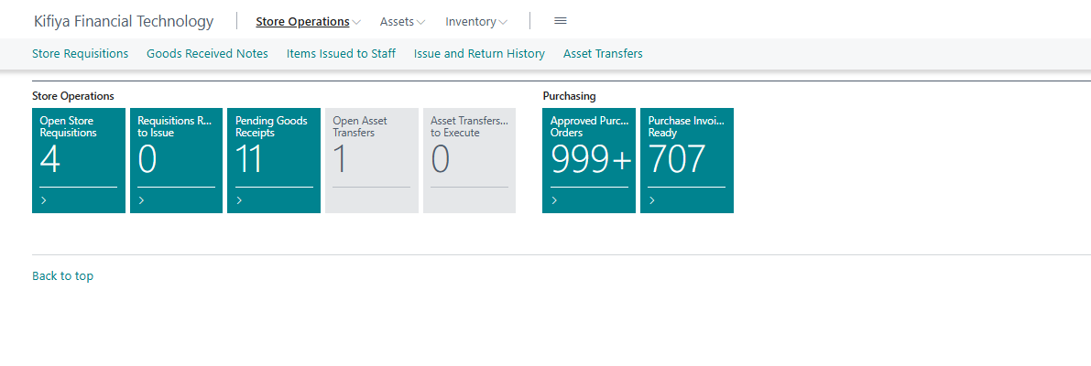
Your home page: Store Keeper role centre
1. Sign in with your own user name.
2. Three drop-downs at the top: Store Operations, Assets, Inventory:
Store Requisitions, Goods Received Notes, Purchase Orders, Posted Purchase Invoices, Items Issued to Staff, Asset Transfers, Asset Register, Inventory Register

Slide 7
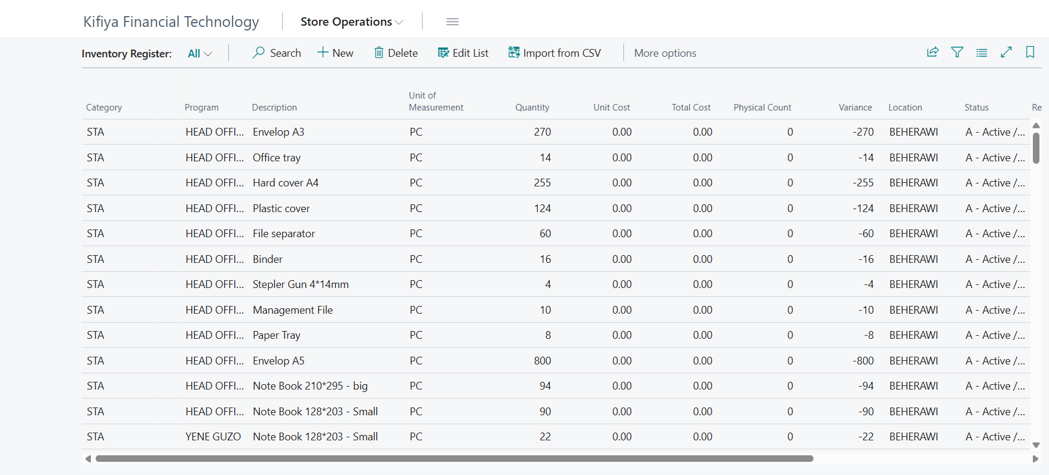
Inventory Register (consumables)
Menu: Inventory Register
Quantity = what the system says
Physical Count = what you counted
Variance = the difference (must be explained)
Click Mark Counted Today after counting
Import from CSV = opening load only
Never edit Quantity to hide a variance. Report it to the Store Manager.

Slide 8
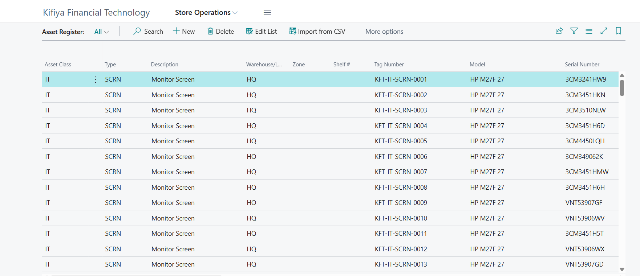
Asset Register (tagged assets)
Menu: Asset Register
One row = one physical unit with a Tag No.
Availability: Available / Issued / Disposed
Split into Tagged Units: one row becomes many, each tagged
Generate Tag No.: for rows with no tag
Asset Register Summary: totals by type and model
Stick the Tag Number label on every physical asset.

Slide 9
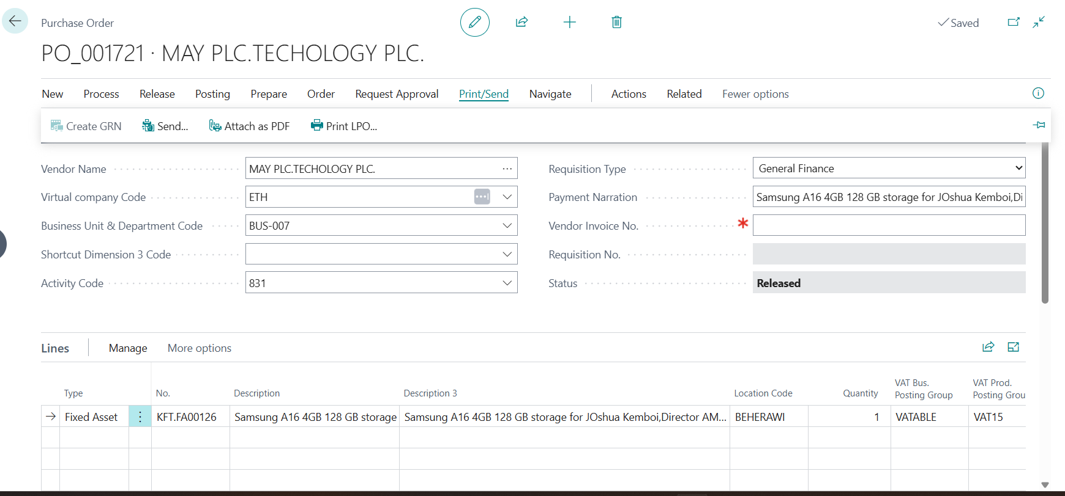
Step 1: Create the GRN
From a Purchase Order:
Home tile Approved Purchase Orders > open the order > Print/Send tab > Create GRN
From an invoice:
Posted Purchase Invoices > open > Create GRN
Multi-unit lines are split into one line per unit automatically

Slide 10
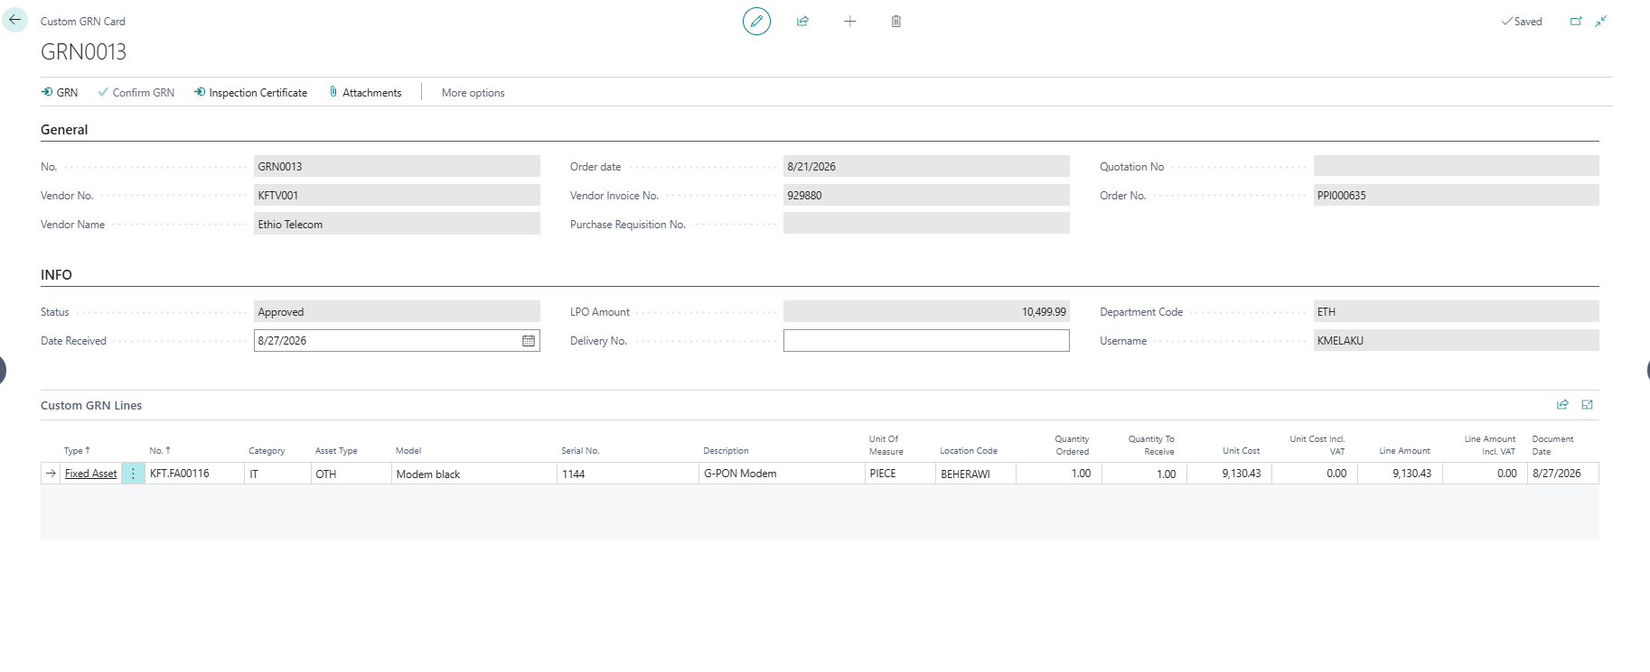
Step 2: Complete and confirm the GRN
Goods Received Notes > open GRN (status Pending)
Check quantity against the physical delivery
Assets: fill Category, Asset Type, Model, Serial No.
Click Confirm GRN
Result: new Tag Nos in Asset Register; new rows in Inventory Register
There is no approval after Confirm GRN. Check before you click.

Slide 11
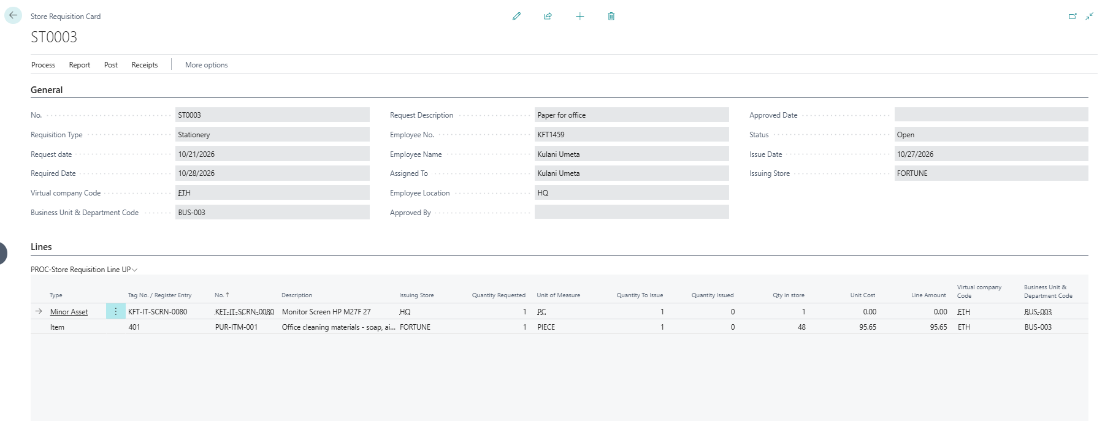
Employee request: create the Store Requisition
Who: the employee
Store Requisitions > New
Enter Employee No. and description
Add lines: item or asset and quantity
Status stays Open, waiting for approval

Slide 12
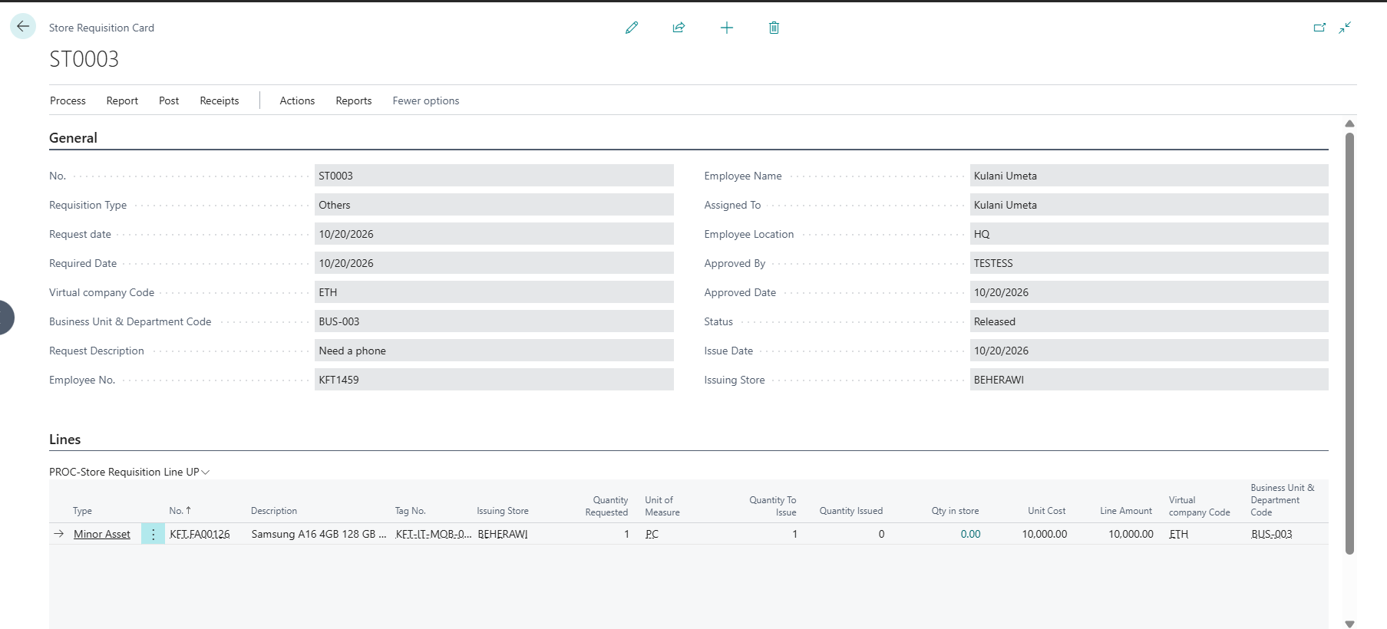
Store Manager approves
Who: the Store Manager
Store Requisitions > open the requisition
Check person, item and quantity
Click Approve for Issue
Status becomes Released; Approved By and date are stamped
Nothing leaves the store without approval. You cannot approve your own request.

Slide 13
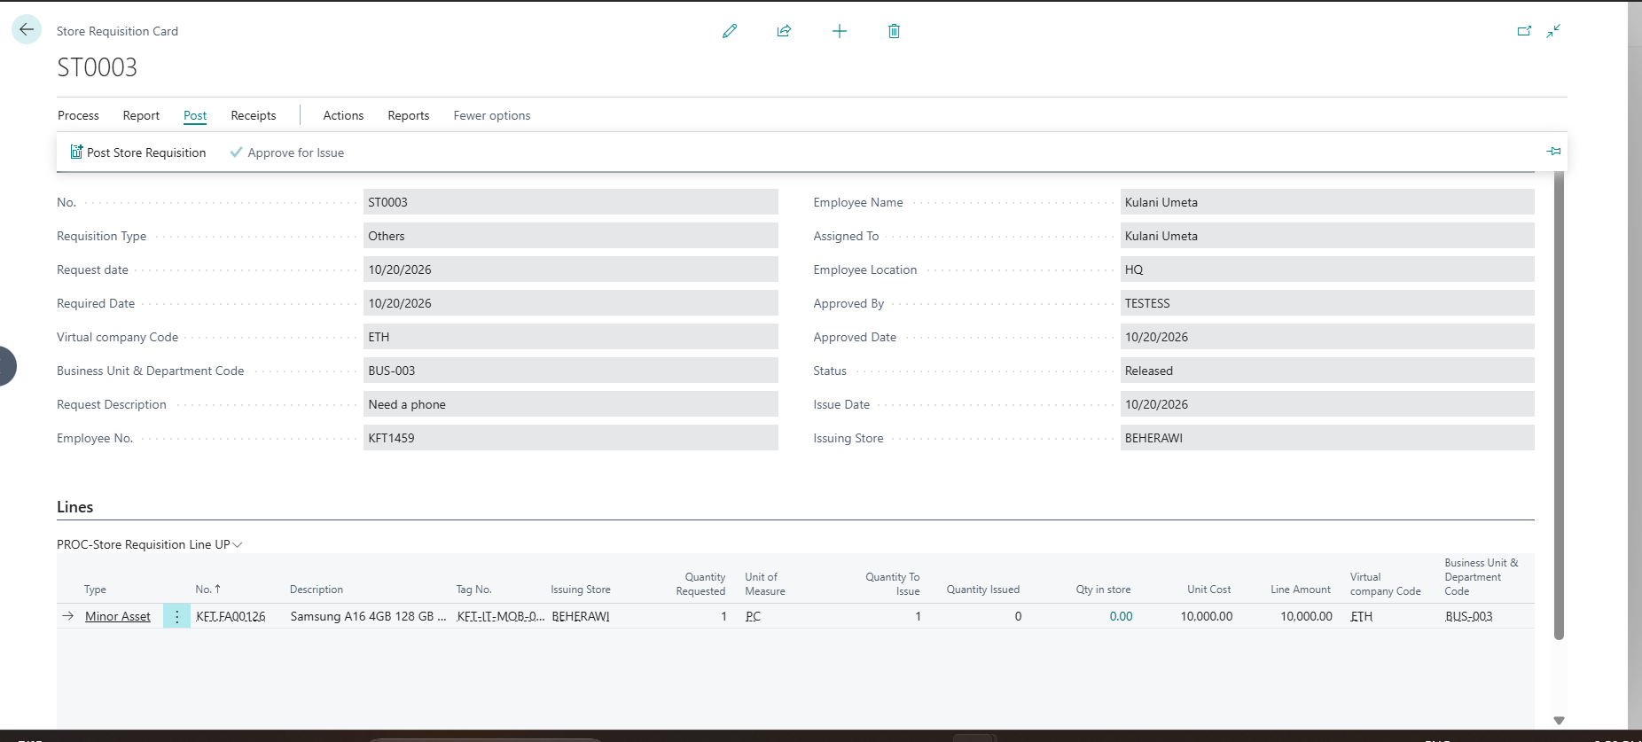
Store Keeper issues
Home page tile: Requisitions Released to Issue
Open the requisition
Asset: enter the Tag No. (only Available units)
Hand over; employee signs
Click Post Store Requisition
Click Items Issued to Employee to confirm
Asset: becomes Issued. Consumable: stock reduced, nothing expected back
An asset line without a Tag No. will NOT update the Asset Register.

Slide 14
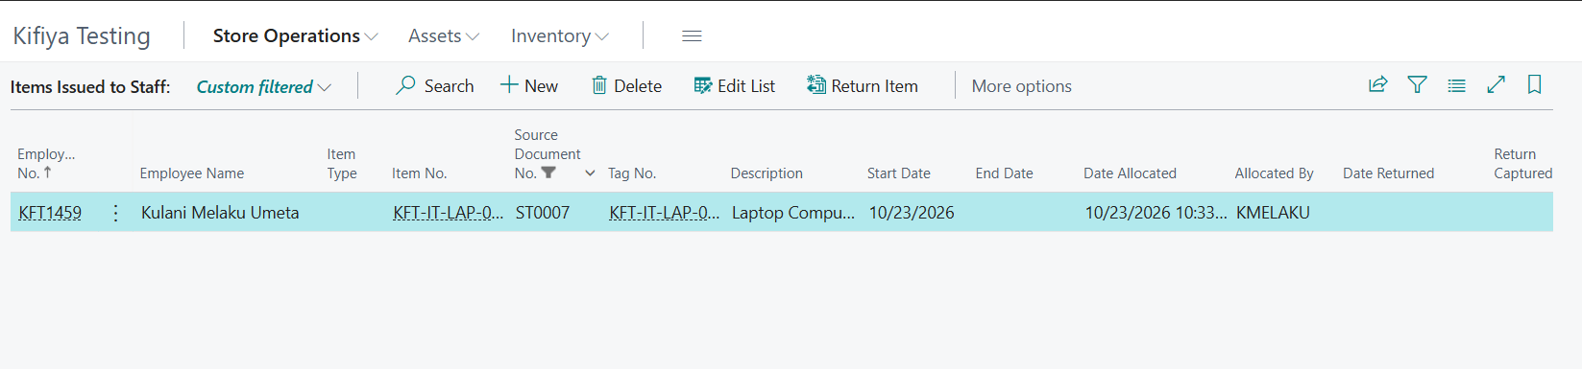
Employee returns an item or asset
Items Issued to Staff
Find the employee row (filter by Employee No. or Tag No.)
Inspect the asset
Select the row and click Return Item
Asset goes back to Available; Return Date and Return To are filled
Shelve it; note any damage in Remarks
Consumables are used up and are not returned.

Slide 15
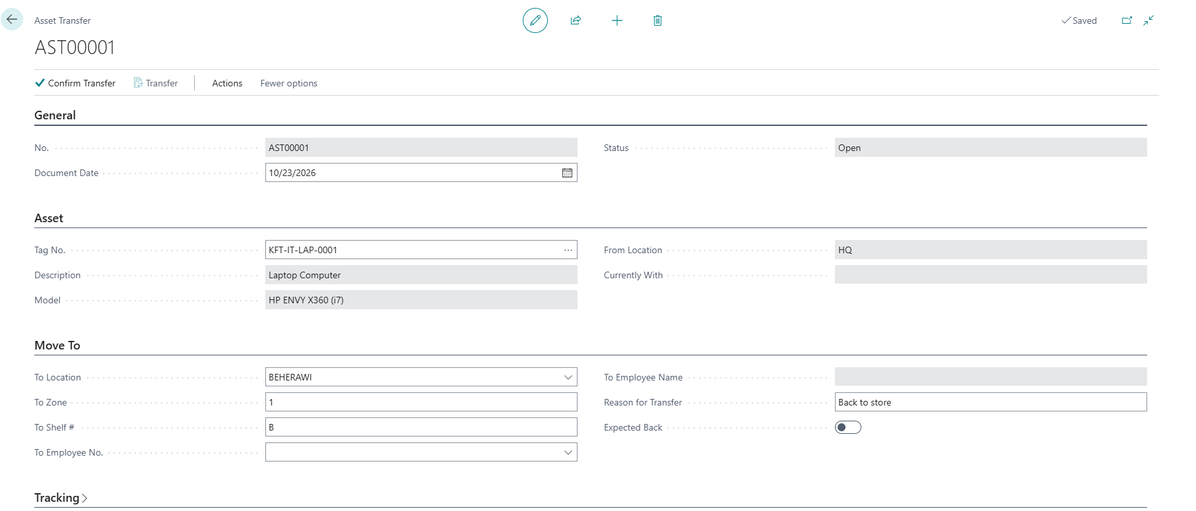
Asset transfer and disposal
Transfer: Asset Register > select the unit > Transfer Asset
Store Manager confirms; store keeper clicks Transfer
New location, new employee, or both
Disposal: Asset Register > set Disposal Method > Request Disposal
A Disposal Approver (not the store keeper) approves or rejects

Slide 16
Physical count
Consumables: enter Physical Count, review Variance
Assets: check each Tag No., Mark Counted Today
Item cards: enter counts in the Phys. Inventory Journal
Do NOT post the journal: the Store Manager reviews and posts
[ SCREENSHOT ]
Phys. Inventory Journal with counted quantities

Slide 17
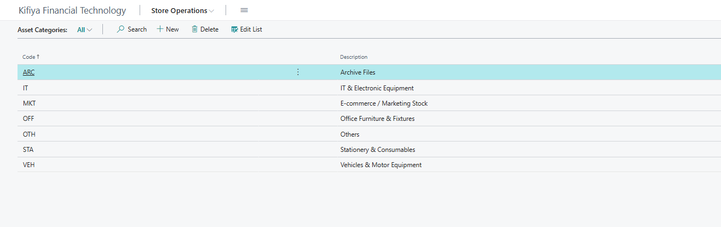
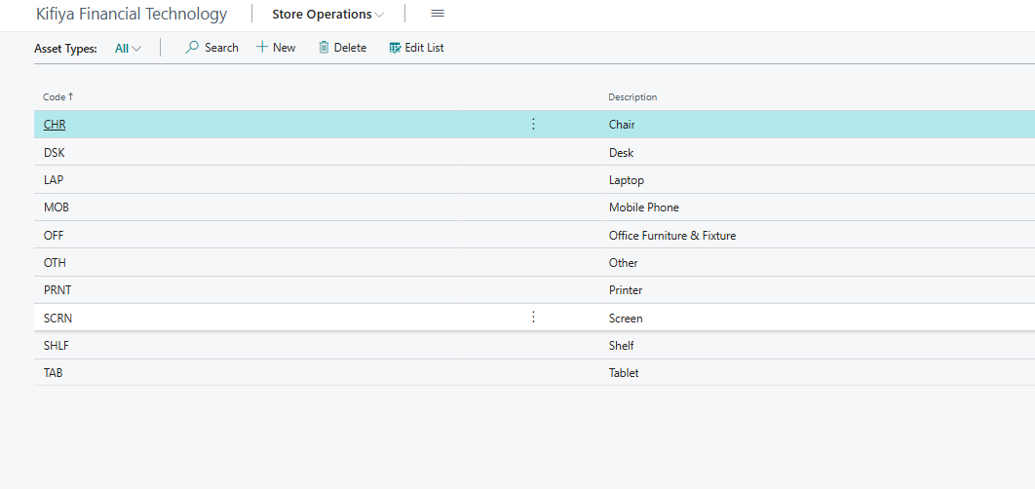
Setup lists: Asset Categories and Asset Types
Each code has a description. The Asset Register Description comes from the Asset Type (e.g. MOB = Mobile Phone).
Give every code a proper description before you start receiving stock.

Slide 18
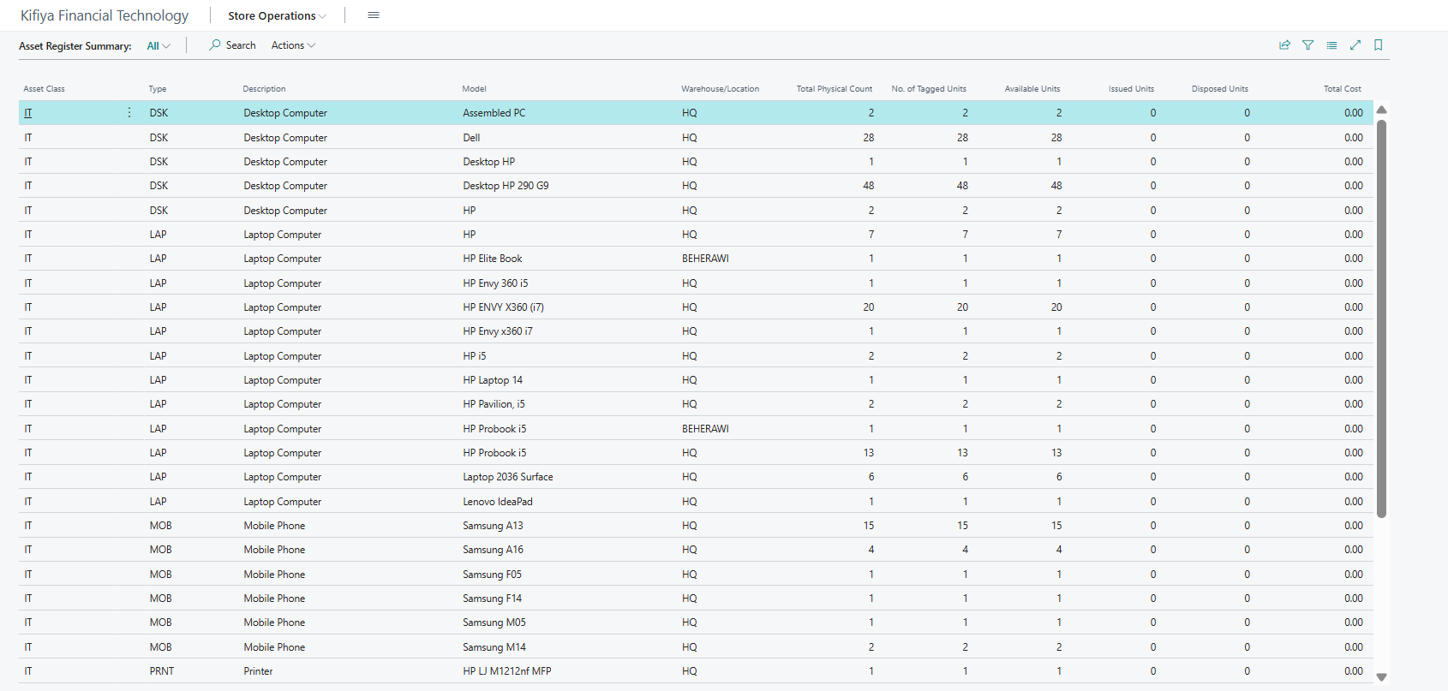
Asset Register Summary
Menu: Asset Register Summary
Totals by class, type, description and model
Available / Issued / Disposed units
Show Tagged Units opens the units behind a total

Slide 19
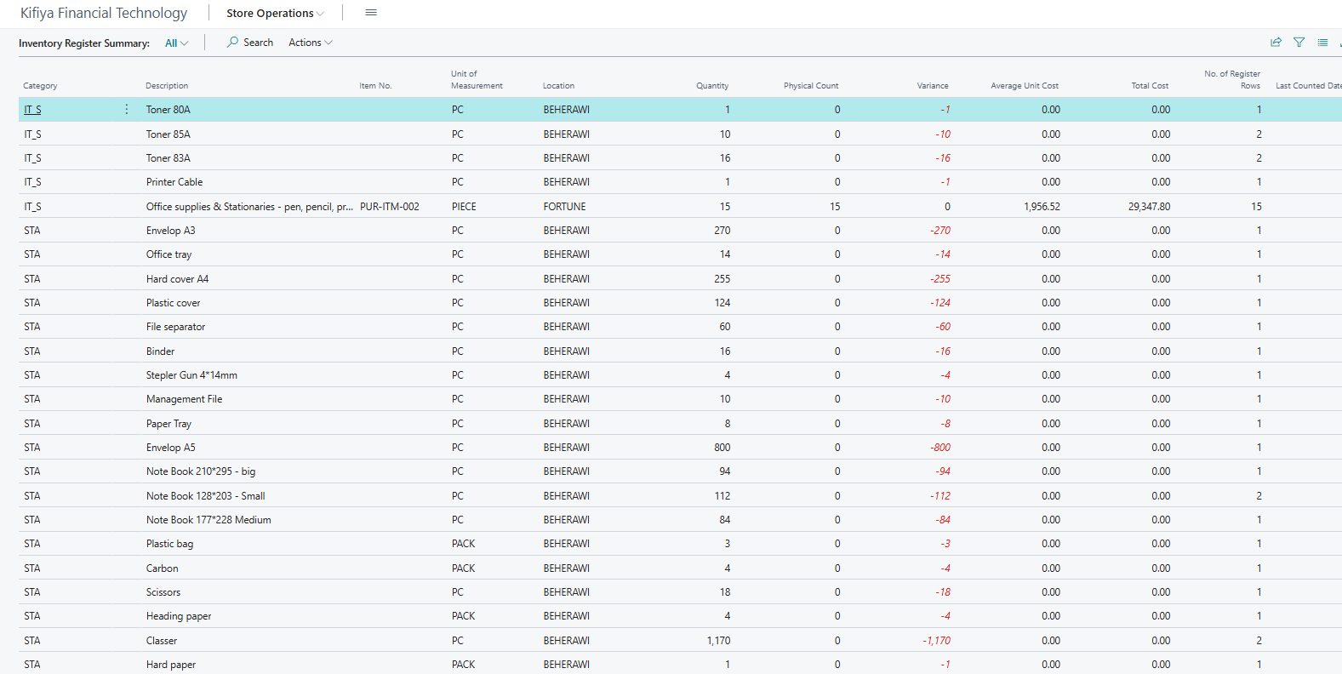
Inventory Register Summary
Menu: Inventory Register Summary
One row per item, rolled up from the register
Quantity, Physical Count and Variance (red when not 0)
Show Register Rows opens the rows behind a total
A GRN adds one register row per unit received, so use the summary for the real picture.

Slide 20
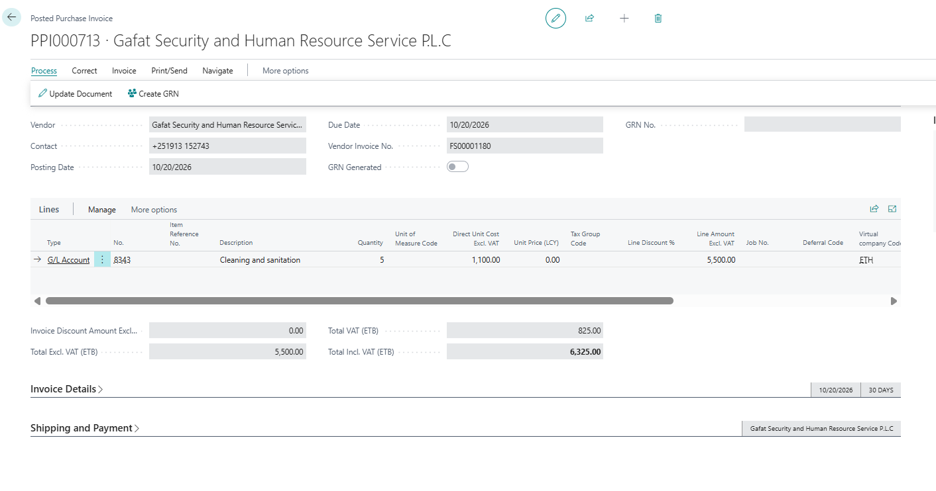
Create GRN from a Posted Purchase Invoice
Home tile Purchase Invoices Ready > open the invoice
Process tab > Create GRN
Enabled only while GRN Generated is off
Lines are split one per unit, as with a purchase order

Slide 21
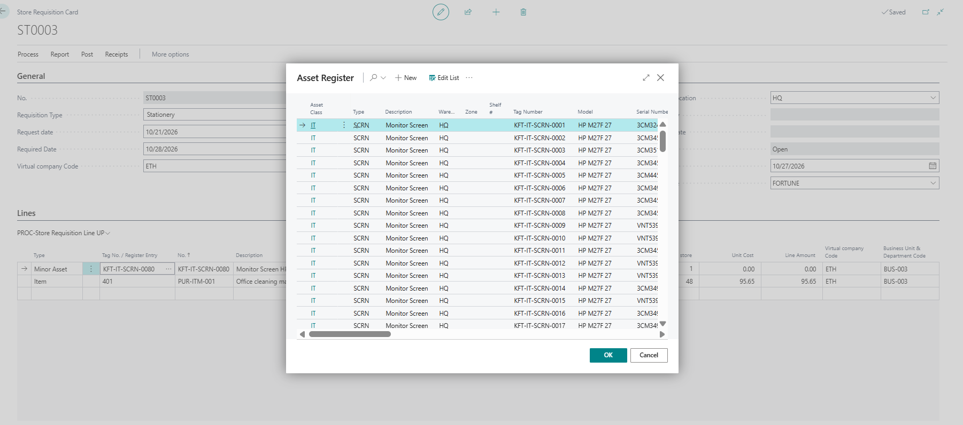
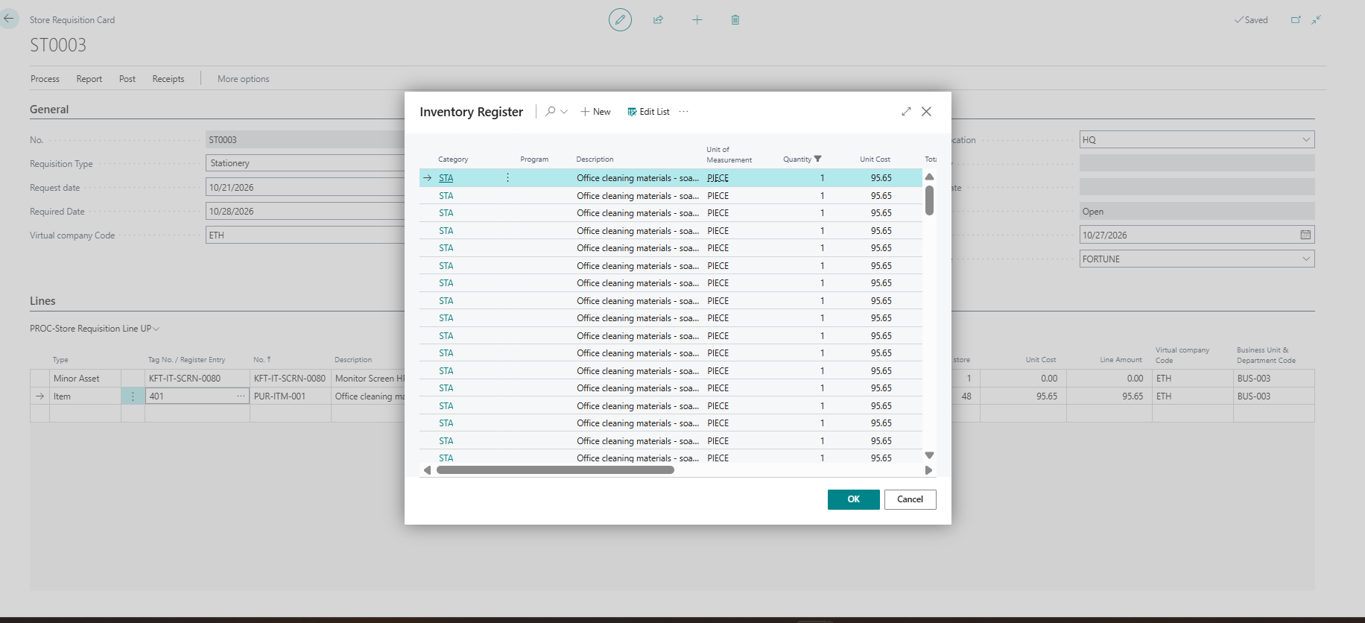
Choosing from the registers on a requisition
Set the Type first, then use the Tag No. / Register Entry field.
Asset: pick the unit from the Asset Register. Item: pick the row from the Inventory Register.
The rest of the line fills in from the register.

Slide 22
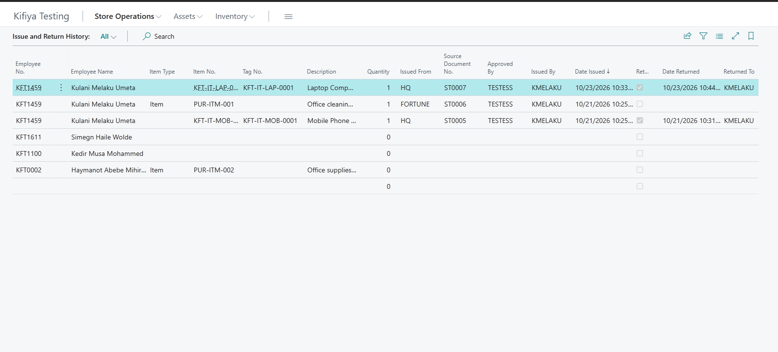
Issue and Return History
Every issue and return is kept: who, what, how many, from which store, who approved and who issued.
Open it from Store Operations, or from one unit in the Asset Register to see everyone who has held it.

Slide 23
Rules to remember
- Never receive without a GRN. Never issue without a posted Store Requisition.
- Always pick the Tag No. for assets.
- Do not create Item or Fixed Asset cards. Ask Finance.
- Do not post depreciation, disposals or stock adjustments.
- Never hide a variance. Report it.
- Everything you post is recorded against your user ID. Never share your password.

